Slide 1
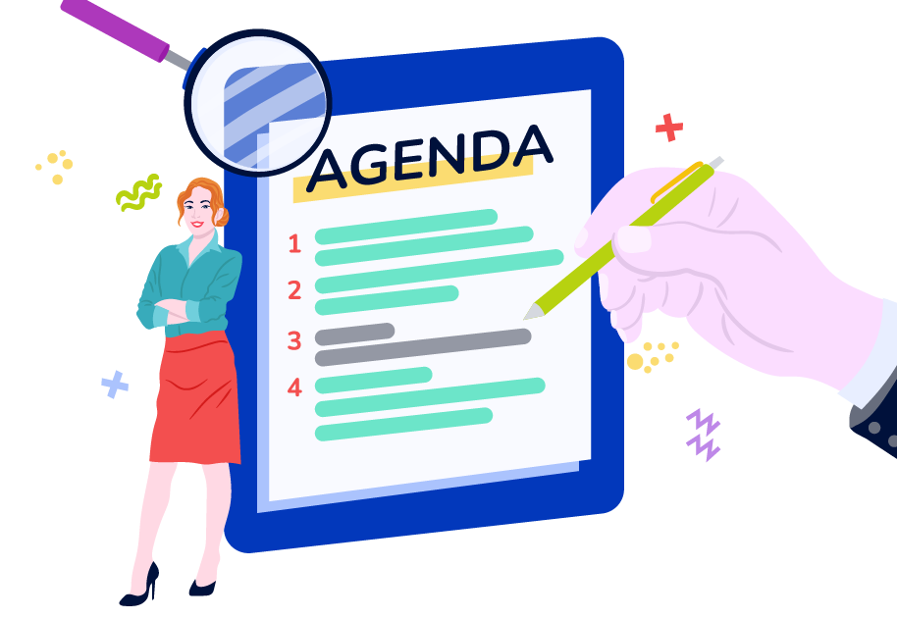
Agenda
Dados em todos os lugares
Data-driven companies
Data Literacy
Data Analytics
Celso Poderoso
cpoderoso@gmail.com
@cpoderoso
www.linkedin.com/in/cpoderoso

Slide 2

O mundo cercado por dados

Slide 3
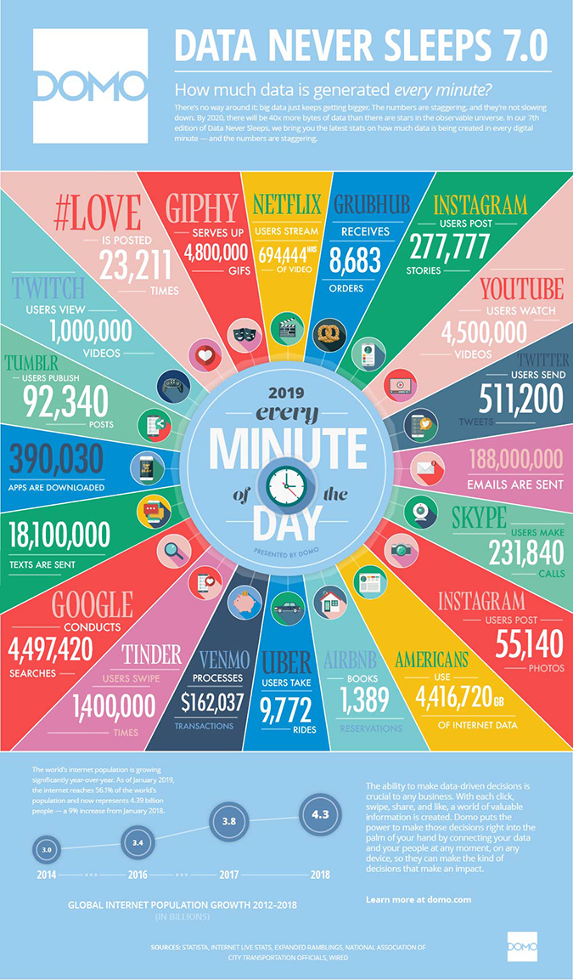
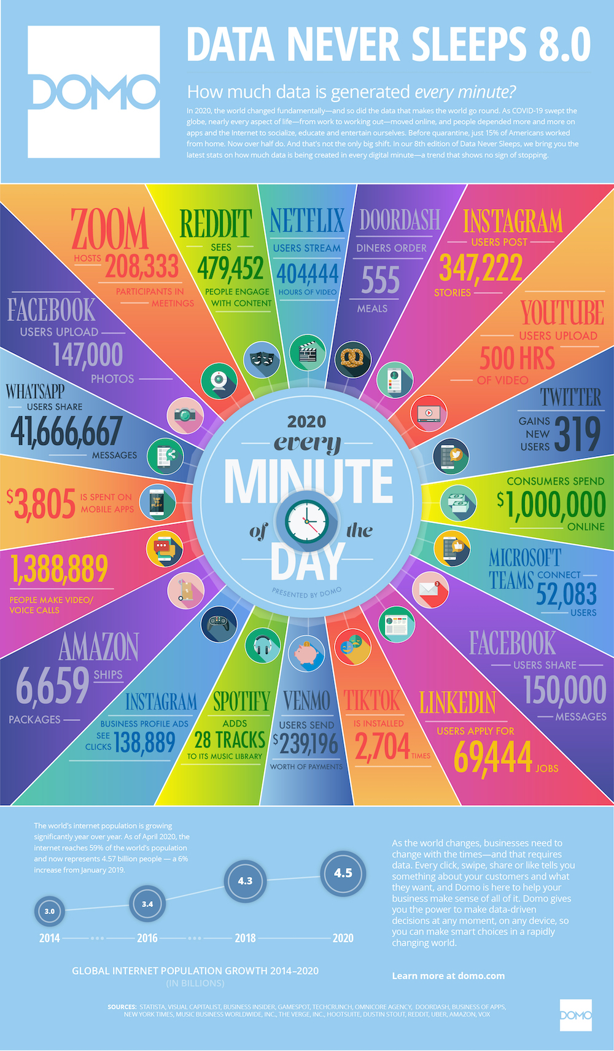
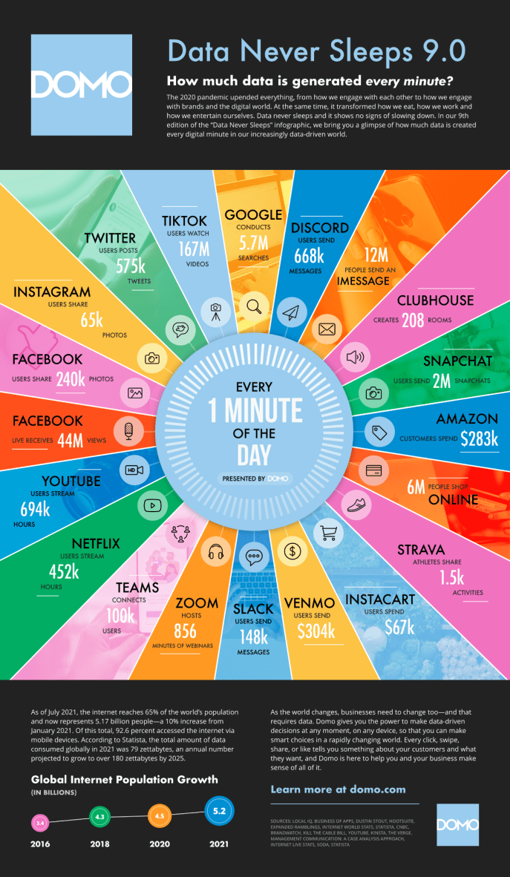

Slide 4
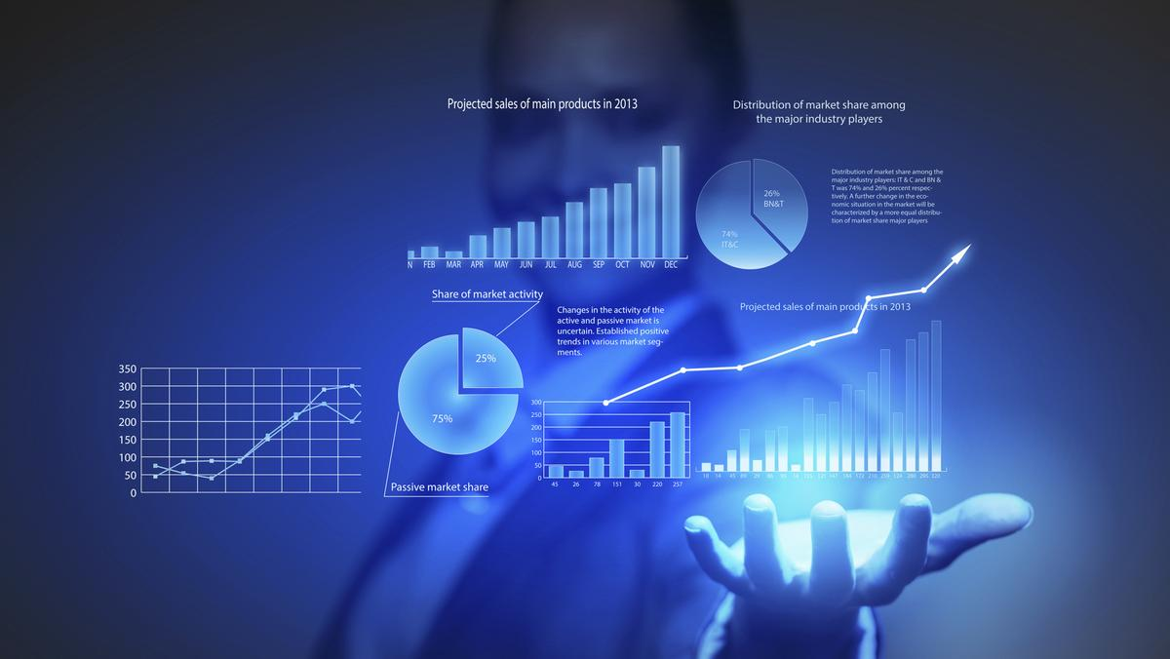
Data-driven Decision Making
Notes:
Citizen Data Scientist
Self-service Analytics
Core Data Management fundamentals

Slide 5

Data Literacy
Notes:
Read Data >> Communicating with Data >> Working with Data
Statistical Literacy > Computational Skills > Visualization Literacy > Digital Literacy > Critical Thinking > Ethical / Legal Literacy > Disciplina-specific Literacy
Bias & Fallacies + Data Fundamentals + Analytical Methods+ Probability & Uncertanty

Slide 6
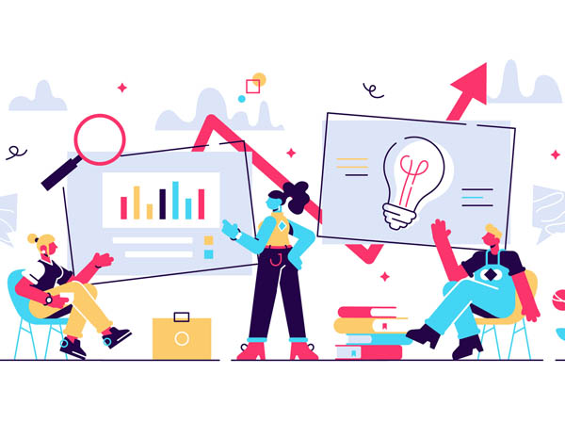
Data Analytics
Descriptive (what happened)
Diagnostic (why happened)
Predictive (what will happen)
Prescriptive (how to act)
Notes:
ML and AI goals: assertivity difference between human predictions and AI predictions.
Insurance fraud case
2022.05.23: Gato, from Google Lab, capable to play Atari, caption images, chat and move robot Arms between others. Open path to AGI (Artificial General Intelligence)

Slide 7

Celso Poderoso
cpoderoso@gmail.com
@cpoderoso
www.linkedin.com/in/cpoderoso

